Slide 1




Our Approach to
Siyapatha’s Digital Vision
Copyright © 2025 Intellect Consulting. All Rights Reserved.

Slide 2


Digital Transformation Is Not About Systems.
It’s About the Business
Digital transformation is a strategic paradigm shift, not an IT project.
Technology (CRM, automations, analytics, integrations etc.) is just an enabler.
Replacing informal practices with transparent, digitally measurable processes.
Teams and individuals adopt new behaviors
Real transformation
happens when
Leaders drive accountability with aid of Data
The entire organization aligns around Customer centric value
Our commitment is to support your business transformation, not just deliver software.
Copyright © 2025 Intellect Consulting. All Rights Reserved.

Slide 3
CRM as Part of the Bigger Digital Picture
CRM supports lead management, customer engagement, and service quality.
But real impact comes when it connects with other digital initiatives — call centre, automation, analytics, and customer channels.
CRM is central hub of a broader digital transformation.
CRM is a foundation, not the full transformation.
Most CRM projects fail not because of the tool, but because staff still work in the old way (Excel, WhatsApp, manual notes).
Copyright © 2025 Intellect Consulting. All Rights Reserved.

Slide 4

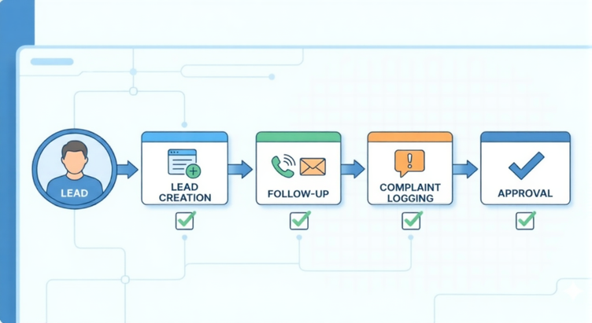
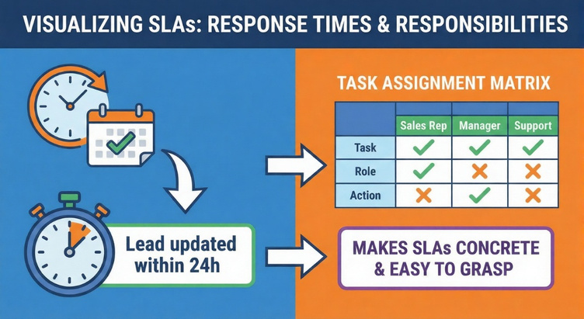
Success = Tools + SOPs + SLAs + Governance
Clear SOPs linked to CRM
Every key activity (lead creation, follow-up, complaint logging, approvals) must have a defined step in the CRM, not outside it.
SLAs & responsibilities
Defined response and update times (e.g. leads updated within 24 hours, complaints status updated daily) with clear owners.
Visible management usage
Every key activity (lead creation, follow-up, complaint logging, approvals) must have a defined step in the CRM, not outside it.
Numerical adoption tracking
Track usage KPIs: % of leads created in CRM, % of complaints logged in CRM, Active users per branch / department, Make these numbers part of performance conversation.
Copyright © 2025 Intellect Consulting. All Rights Reserved.

Slide 5



Measure, Review, Improve
Phase 3:
Measure, Review, Improve
Phase 2 :
Adoption & Process Alignment
Monthly adoption review with management:
Map and adjust SOPs
Usage KPIs by branch and role
Define SLAs and ownership
Data quality checks
Phase 1 :
Go-Live with the Right Tool
Feedback from users and quick improvements
Keep this cycle until we reach agreed success numbers (e.g. >90% of leads and complaints logged via CRM).
Copyright © 2025 Intellect Consulting. All Rights Reserved.

Slide 6

Our Commitment:
A Transformation Partnership
We are not delivering a product—
we are partnering in your digital journey.
Our focus is on real business outcomes, not just system implementation.
We support you end-to-end:
design, rollout, adoption, and continuous improvement.
Success is measured by how your teams use the system and the value it creates.
Copyright © 2025 Intellect Consulting. All Rights Reserved.

Slide 7
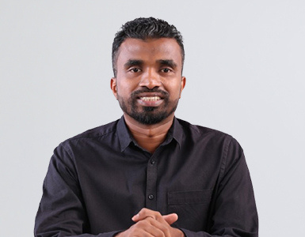
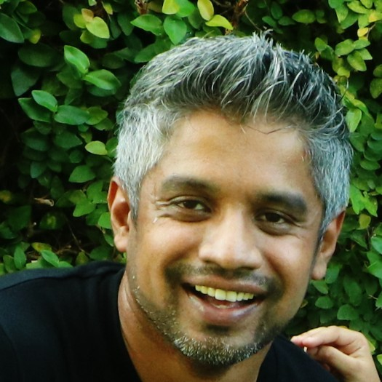
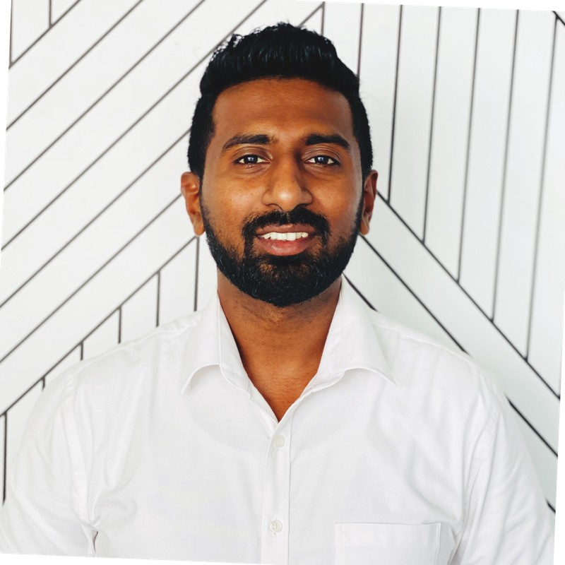
Leadership
Jeewana Premarathne has over 14 years of experience in digital transformation projects and has led numerous initiatives across multiple industries. He brings strong expertise in improving processes, enhancing governance, and guiding organizations toward more efficient, scalable operations.
Gayan Liyanage has over 18 years of experience in software engineering and digital transformation, leading large-scale initiatives across government, healthcare, financial services, and SME sectors in Singapore and Sri Lanka. He specializes in architecting scalable cloud solutions and implementing CRM and enterprise platforms.
Prabodha Dissanayake has 15+ years of experience in IT project delivery, specializing in the banking and financial domain across leading banks in both Sri Lanka and Singapore. He brings strong expertise in managing complex, business-critical projects, ensuring smooth execution and risk-free delivery through deep technical and domain knowledge.
Copyright © 2025 Intellect Consulting. All Rights Reserved.

Slide 8

Thank you.
Copyright © 2023 Intellect Consulting. All Rights Reserved.
‹#›

